Slide 1

Hand written digit recognization
TEAM MEMBERS
Chandra sekhar.k(RA2011003010435)
Shaik hussain ahmed(ra2011003010435)
Vasu buchingari(ra2011003010435)

Slide 2
ABSTRACT
Handwritten character recognition is one of the practically important issues in pattern recognition applications. The main purpose of this project is to build an automatic handwritten digit recognition method for the recognition of handwritten digit strings.
To accomplish the recognition task, first, the digits will be segmented into individual digits. Then, a digit recognition module is employed to classify each segmented digit completing the handwritten digit string recognition task.
The applications of digit recognition include postal mail sorting, bank check processing, form data entry, etc. The heart of the problem lies within the ability to develop an efficient algorithm that can recognize handwritten digits and which is submitted by users by the way of a scanner, tablet, and other digital devices.

Slide 3
Modules Description and Implementation
Data pre-processing: This module involves preparing the data by performing various operations such as normalization, resizing, and gray-scaling to make it suitable for training the model.
Feature extraction: In this module, relevant features are extracted from the pre-processed data. This can be done using various techniques such as edge detection, contour extraction, and texture analysis.
Model training: This module involves selecting an appropriate machine learning algorithm and training the model on the pre-processed data. Popular algorithms for digit recognition include neural networks, support vector machines, and k-nearest neighbors.
Model evaluation: In this module, the trained model is evaluated using a separate test dataset to assess its accuracy and performance.
Deployment: Once the model has been trained and evaluated, it can be deployed for use in real-world applications.
The implementation of a handwritten digit recognition project involves coding the above modules in a programming language such as Python. Popular libraries such as TensorFlow, Keras, and Scikit-learn can be used to simplify the implementation of these modules. The implementation may involve building a user interface for inputting handwritten digits and displaying the recognized digits.
on
Display of rep count and calories burned
Integration on web application

Slide 4
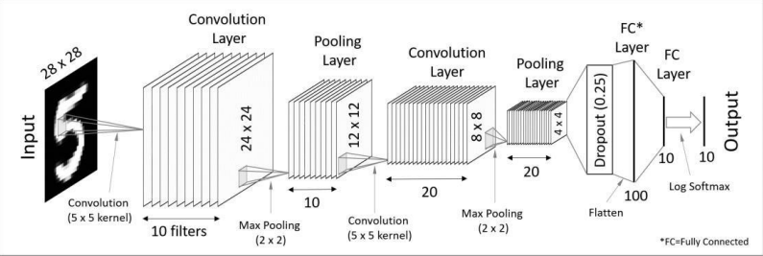
Architecture/Block Diagram of the Proposed model

Slide 5
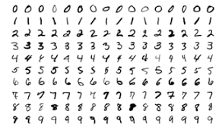
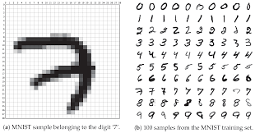
MNIST DATASET

Slide 6
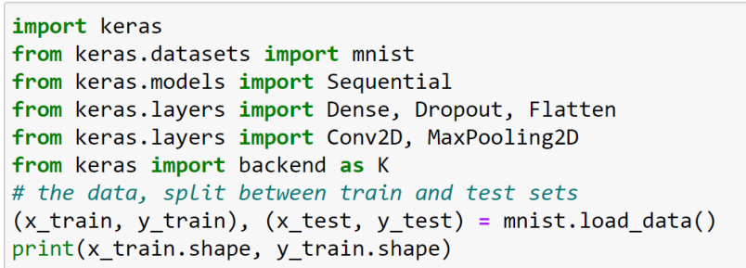
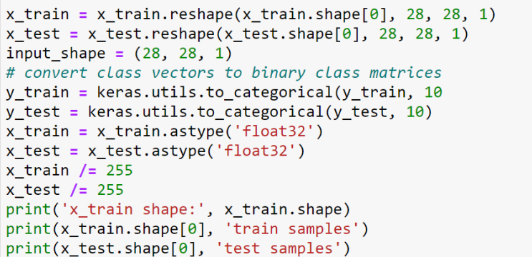
Implementation
Sample code:
Preprocess of data:

Slide 7
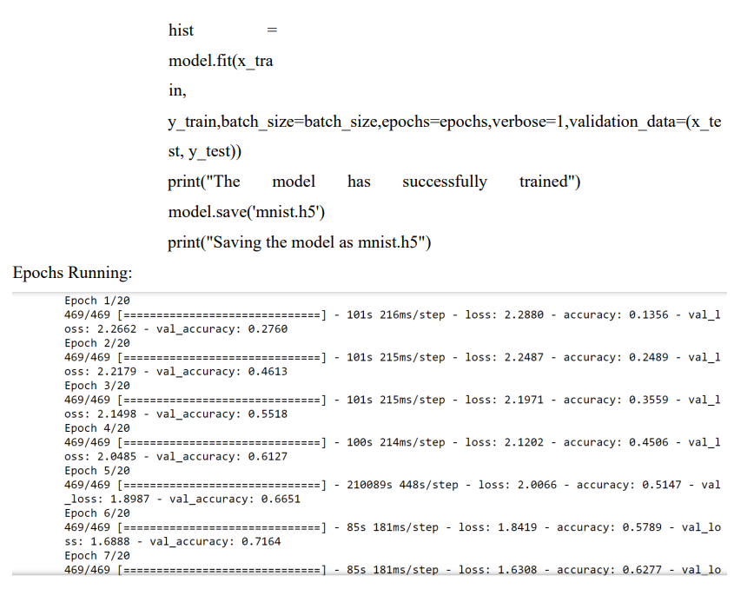
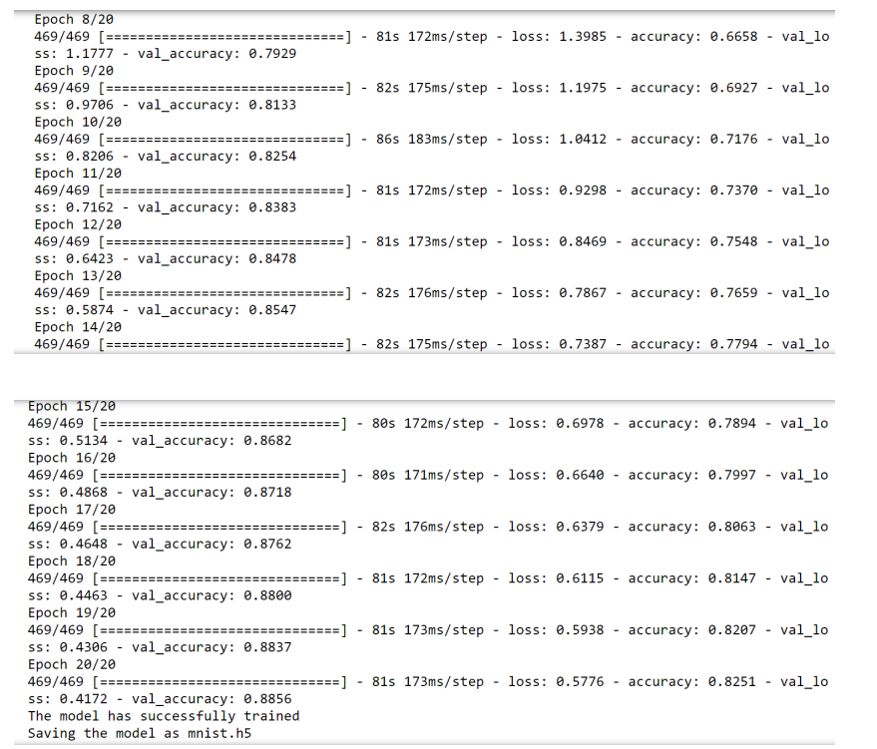
Train the model:

Slide 8
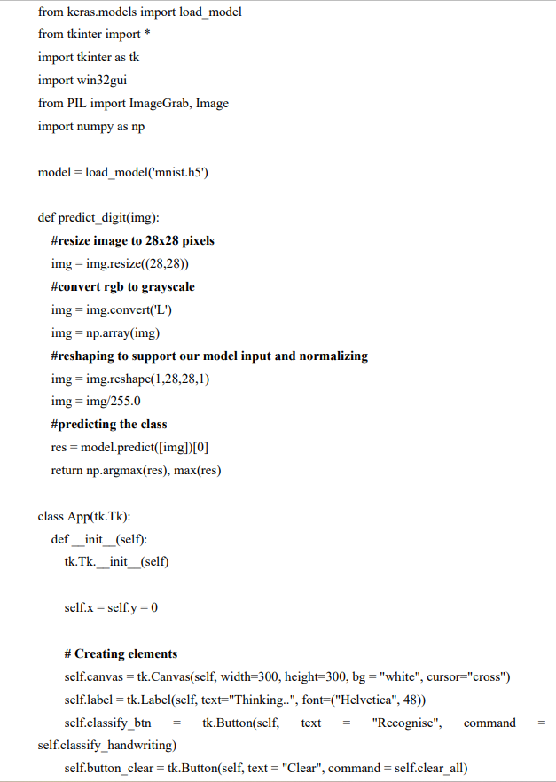
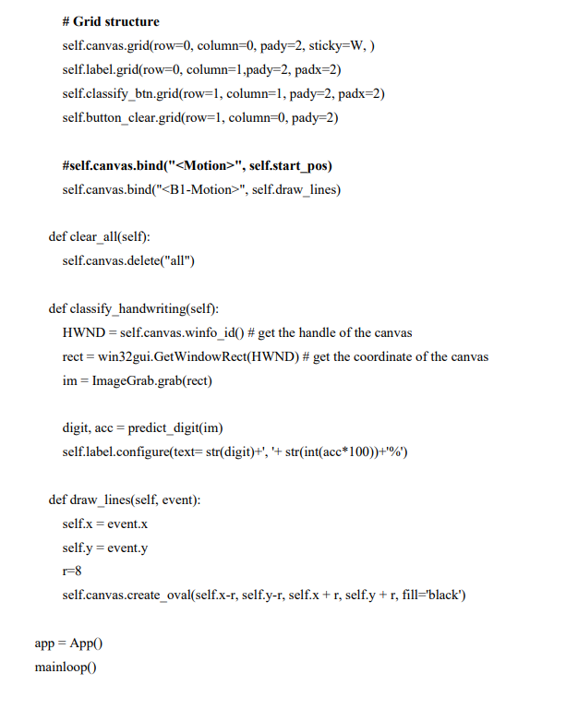
Create GUI to predict digits:

Slide 9
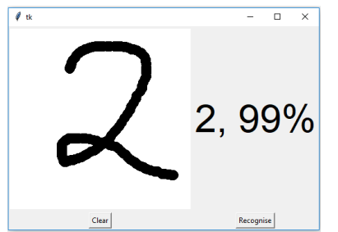
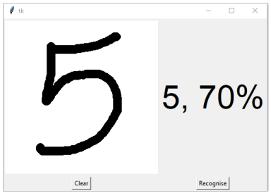
Output:

Slide 10
Conclusion
Our project HANDWRITTEN DIGIT RECOGNITION deals with identifying the digits. The main purpose of this project is to build an automatic handwritten digit recognition method for the recognition of handwritten digit strings. In this project, different machine learning methods, which are SVM (Support Vector Machine), ANN (Artificial Neural Networks), and CNN (Convolutional Neural Networks) architectures are used to achieve high performance on the digit string recognition problem.

